Slide 1
Growing
For Concern
Classification
Ridley Arp 2-23-22

Slide 2
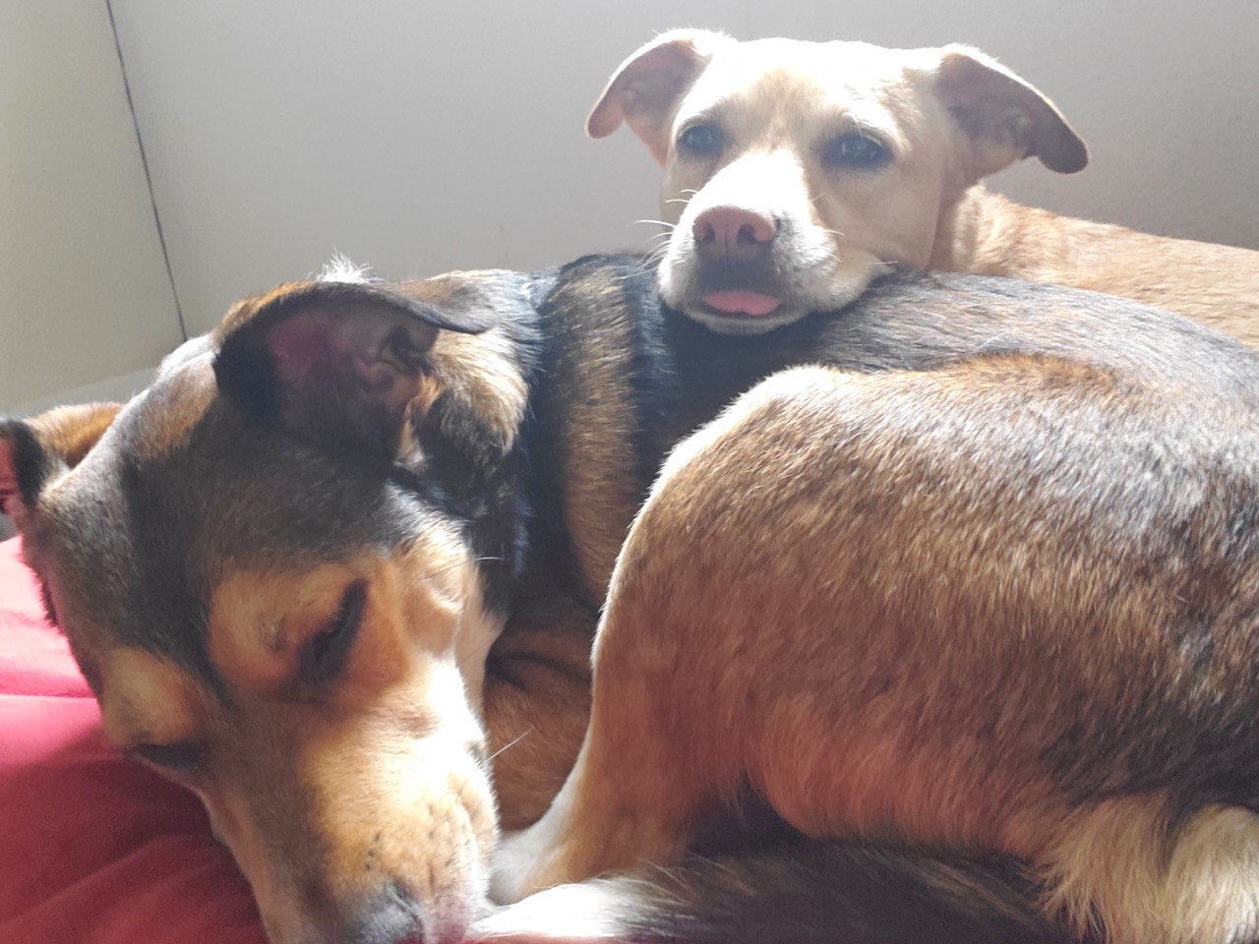
Introduction
Data Used:
SAVSNET Tumour Database
Tools Utilized:
Python Pandas & Numpy for data manipulation
Python Seaborn and Matplotlib for visualizations
Python Scikit-learn and for modeling and ML
Python Seaborn and Matplotlib for visualizations

Slide 3

Methodology
Data Collection and Cleaning
Tumor data sourced from new veterinary database of prior known instances
Feature Engineering
Segmented categorical data to try and determine indicators of multiple tumor count
Modeling and Selection
Trained an ensemble voting classifier to determine likelihood of multiple lesions

Slide 4
Process

Slide 5
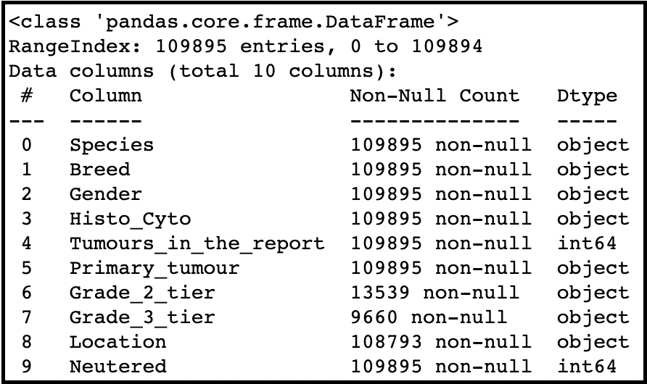
Original Data
Original dataset included various traits about prior cases including physical traits of the animal as well as how and where the tumor was found.
A vast majority of these needed further segmentation to become viable features.

Slide 6
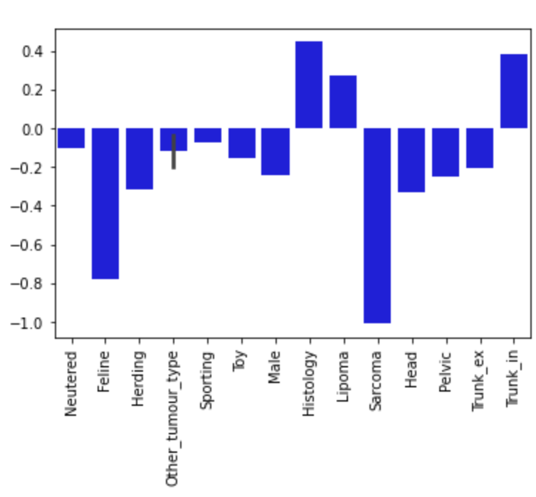
Highest/Lowest risk Features
These features provided the final baseline for modeling and learning
Notable features which did not provide a signal either way:
Non-sporting Breed Group
Lymphoma type Tumour
The Lymph System Location

Slide 7
Results

Slide 8
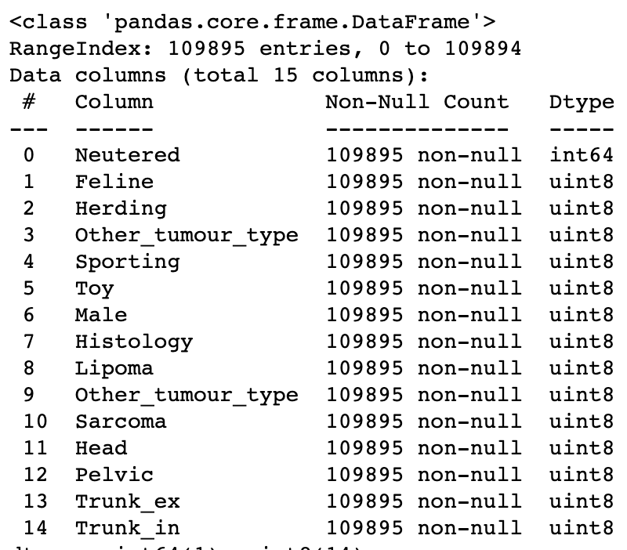
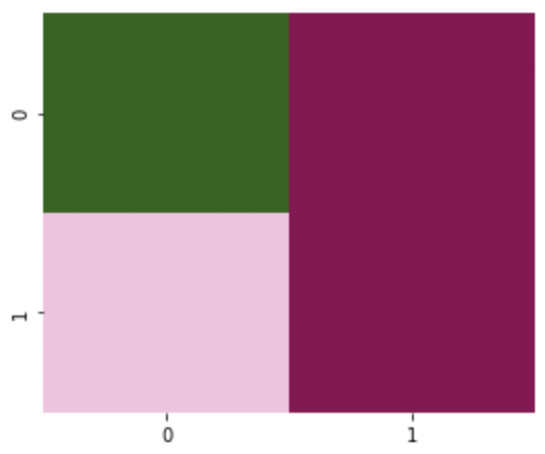
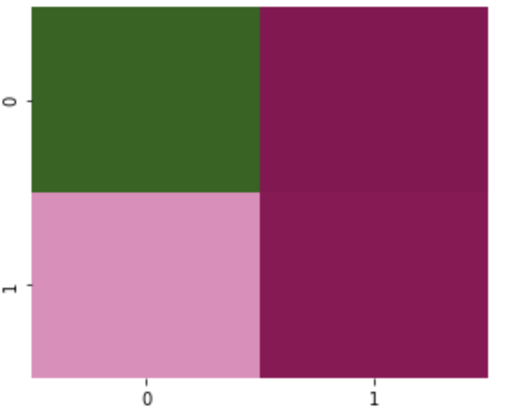
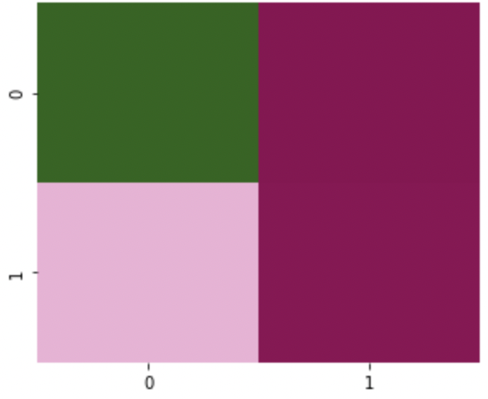
Data Selection & Model Metrics
Logistic Regression
Accuracy score of .749
Decision Tree
Accuracy score of .759
Random Forest
Accuracy score of .749

Slide 9
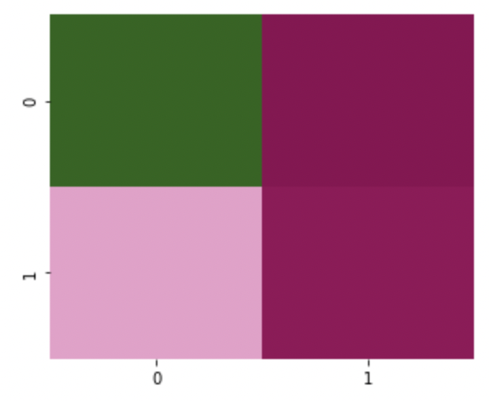
Final Model
Final Model
Voting Classifier Ensemble
Decision tree weighted at 2 to capture more true positives, but struggling to classify negatives
Logistic Regression weighted at 1.4 to compensate for negative difficulties in Decision Tree
Accuracy of .7603 with highest confidence on both Positive and Negative

Slide 10
Further Action and Noteables

Slide 11
Low Risk Features:
Felines significantly more likely to only have one lesion
Sarcoma almost always only presents in one growth
Herding Group dogs less likely to have multiple presentations
High Risk Features:
Multi-growth Cancers are more likely to effect organs and connective tissue than external
Lipoma is most likely to present in multiples
Age not provided in data, but would affect.
Further data acquisition concerning age could temper the results shown here, as increased age in all animals is linked to increase chance of cancer.
Further work with XGBoost would also likely assist in refining negative accuracy overall.

